Slide 1
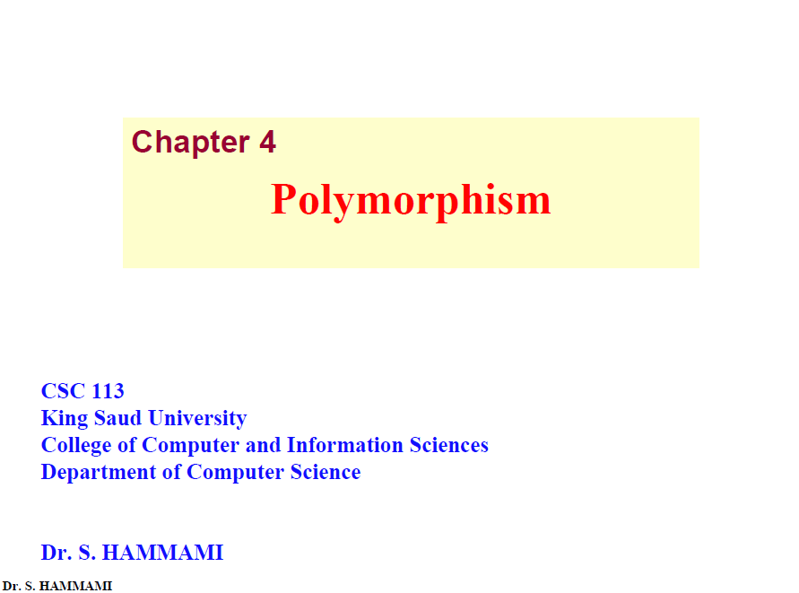

Slide 2
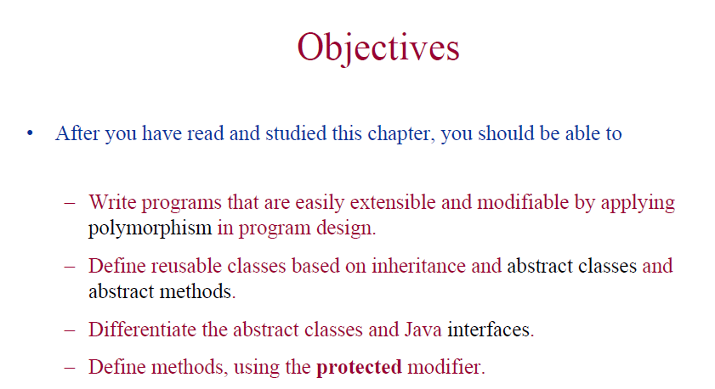

Slide 3
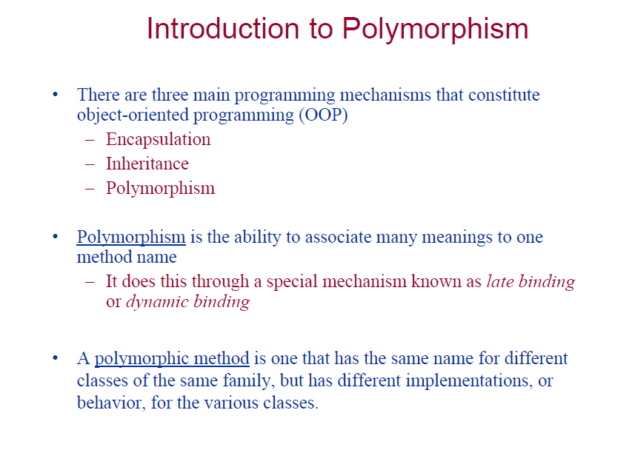

Slide 4
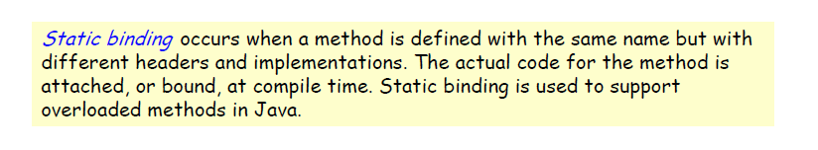
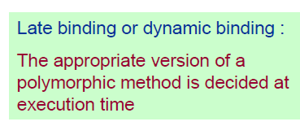
Static Binding Vs. Dynamic Binding

Slide 5
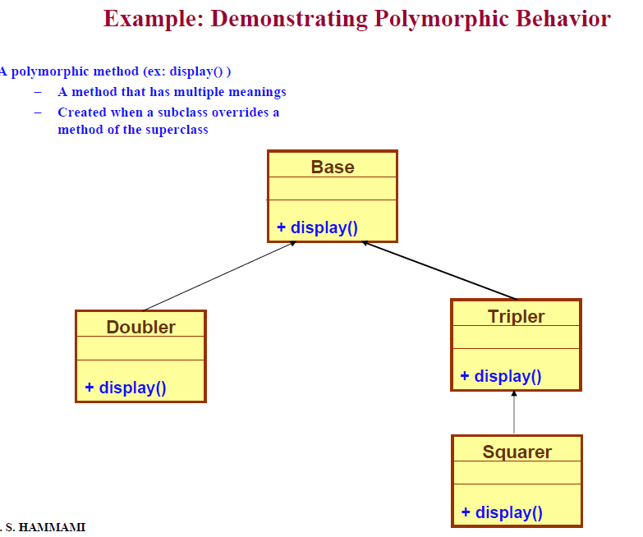

Slide 6
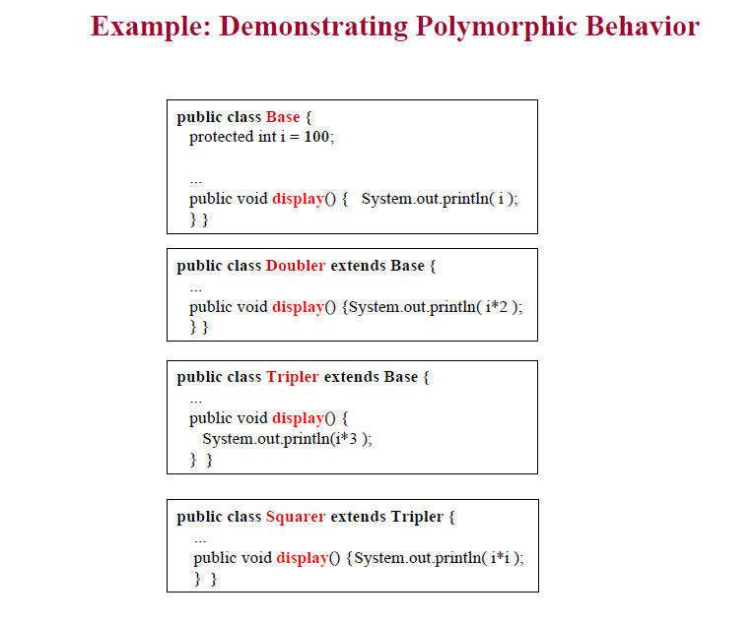
Notes:
You can write a new instance method in the subclass that has the same signature as the one in the superclass, thus overriding it.

Slide 7
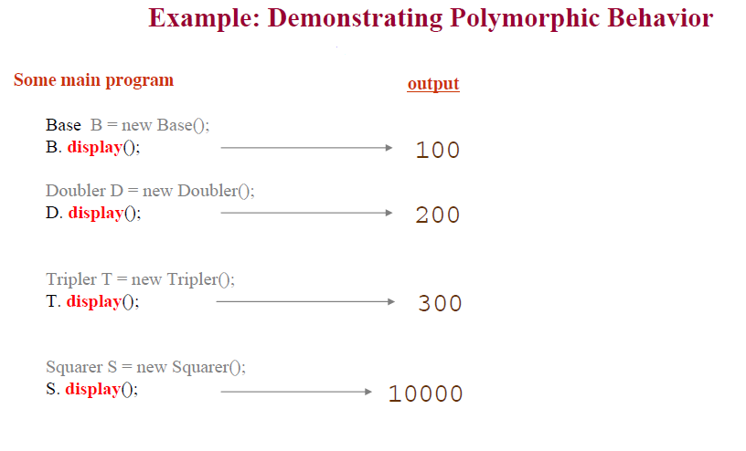
This example show how to use method overridden
We have method display() with different implementation for every subclass

Slide 8
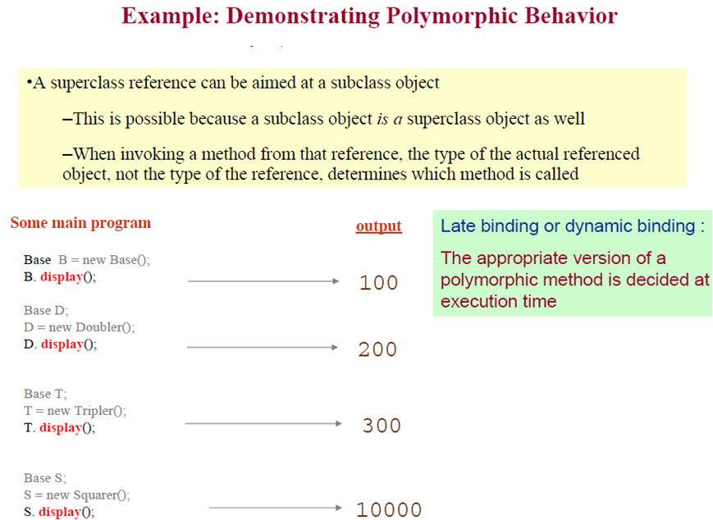
Upcasting
Polymorphic method
Upcasting
Polymorphic method
Upcasting
Polymorphic method
Notes:
Base D=new Doubler() correct
Doubler D= new Base() not correct

Slide 9
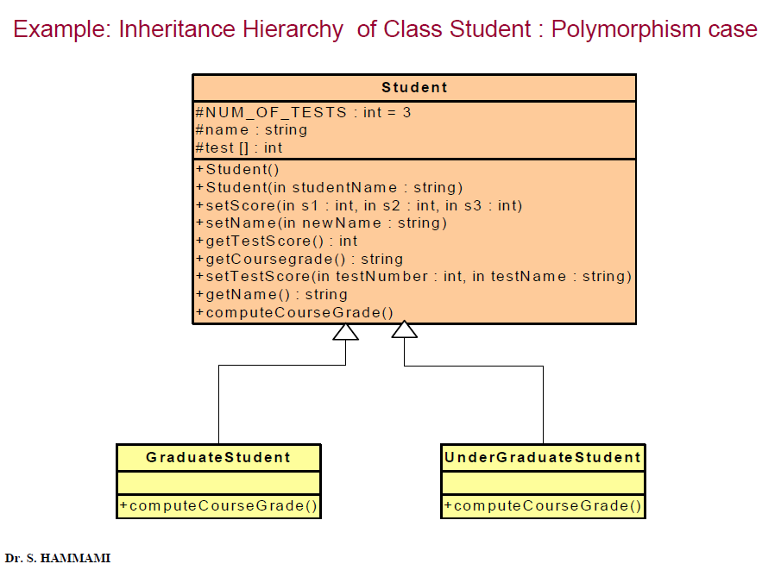

Slide 10
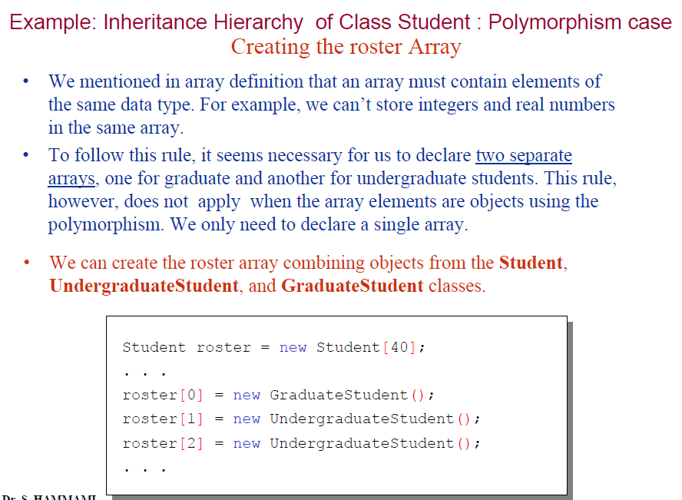

Slide 11
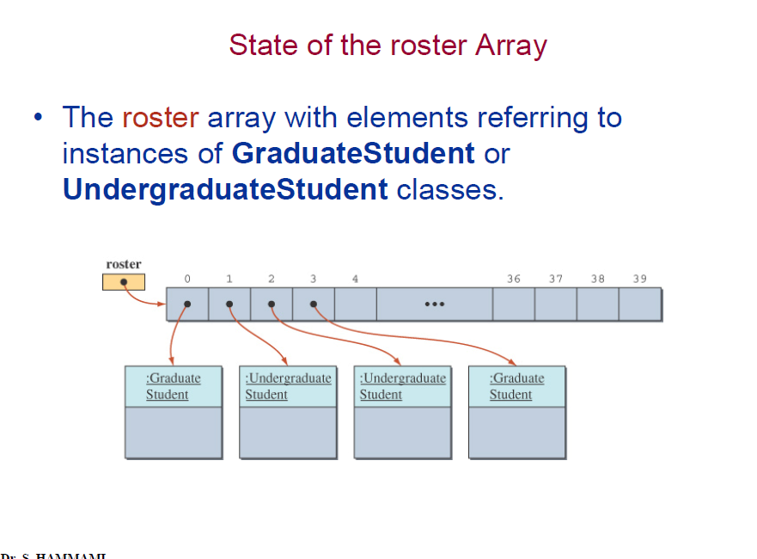

Slide 12
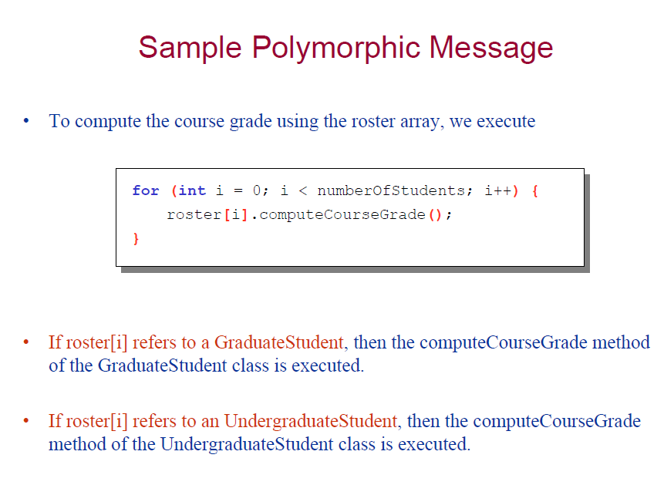
computeCourseGrade() is overridden by GraduateStudent and UndergraduateStudent
Remember : we can override methods only, not the variables(data members)

Slide 13
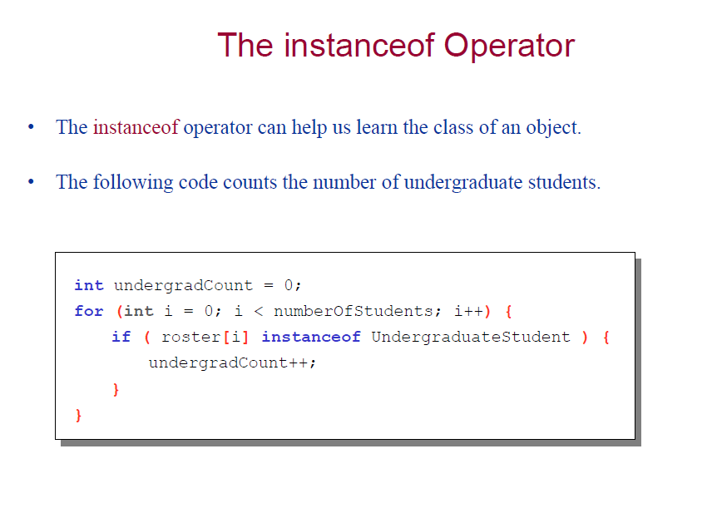

Slide 14
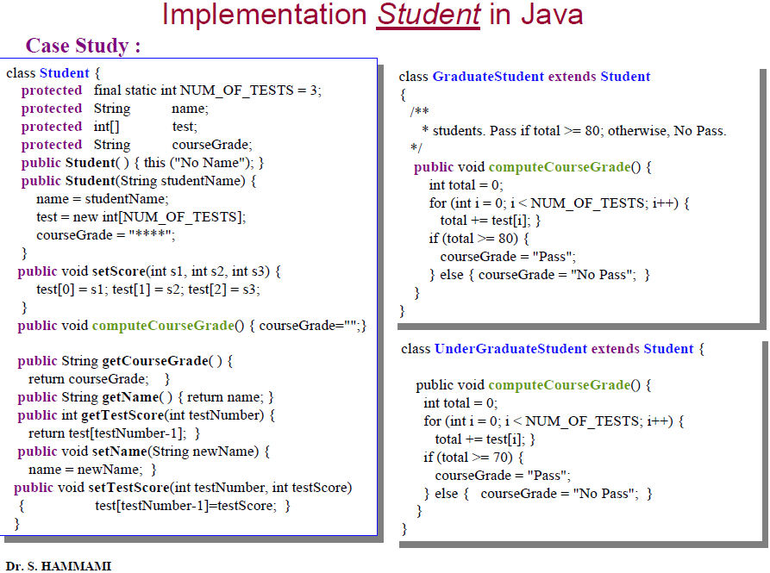

Slide 15
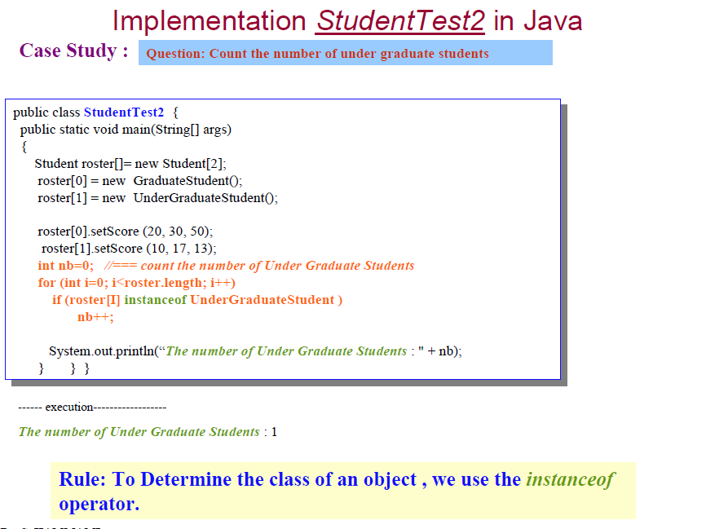

Slide 16
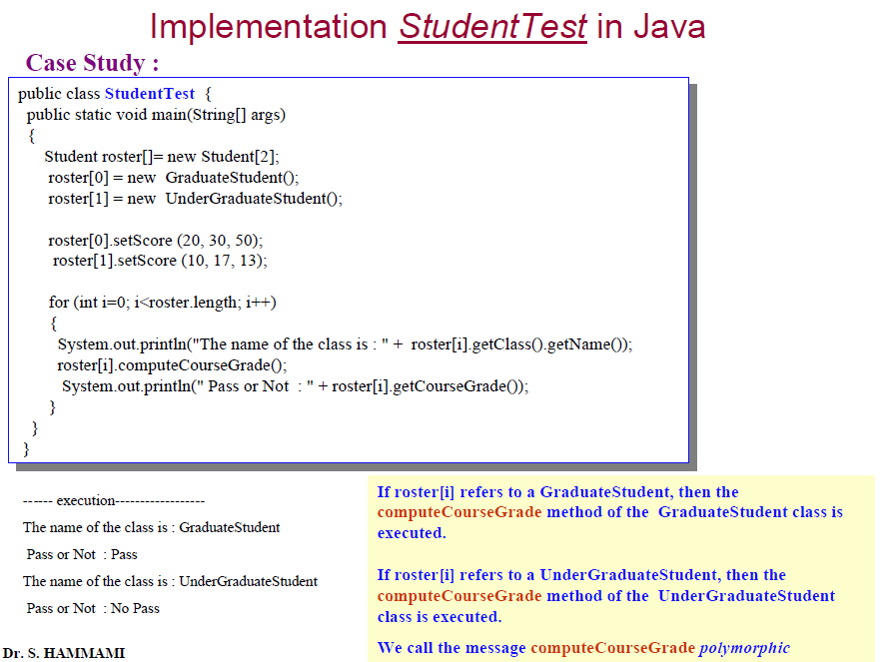
Print the class name of the object
The getClass.getName() returns the name of the class as a String.

Slide 17
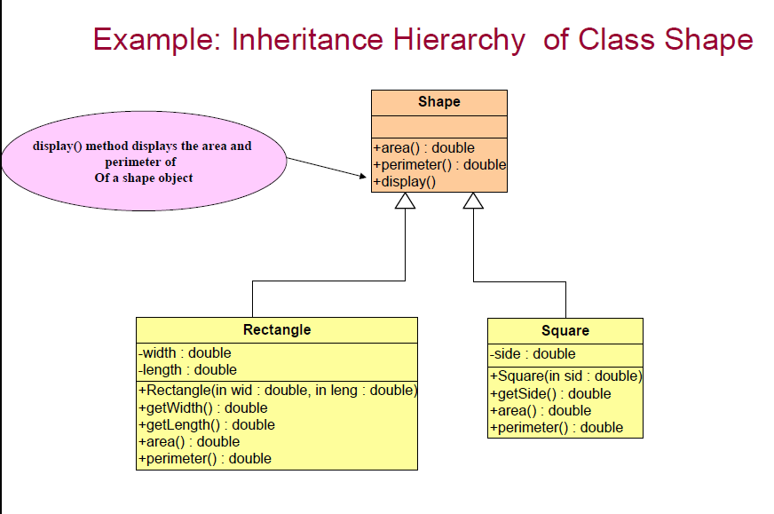

Slide 18
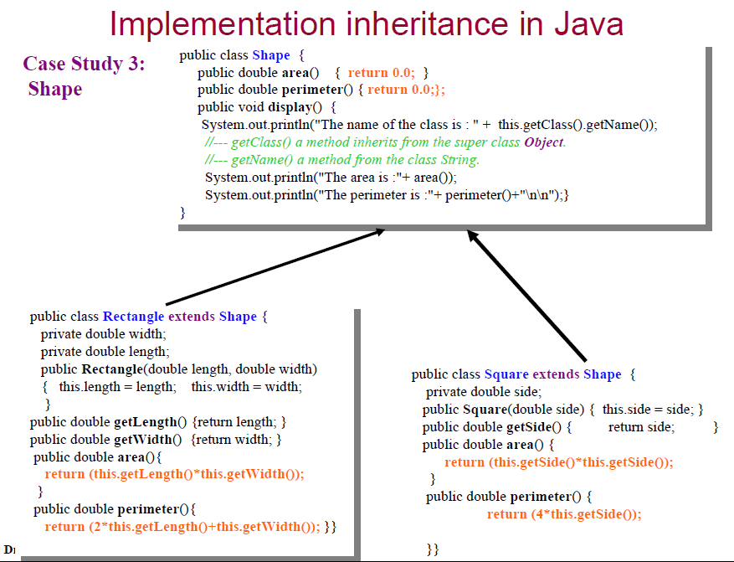

Slide 19
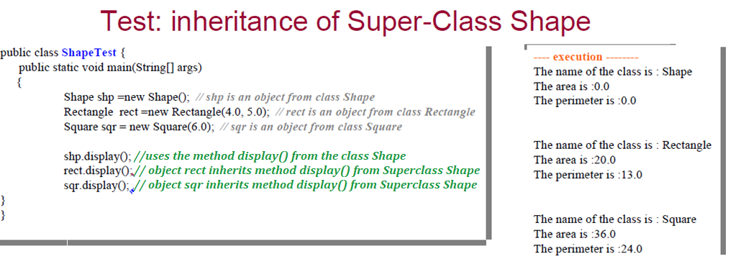
Sch (shape)

Slide 20
rect (Rectangle)
4.0
5.0

Slide 21
sqr (Rectangle)
4.0
5.0

Slide 22
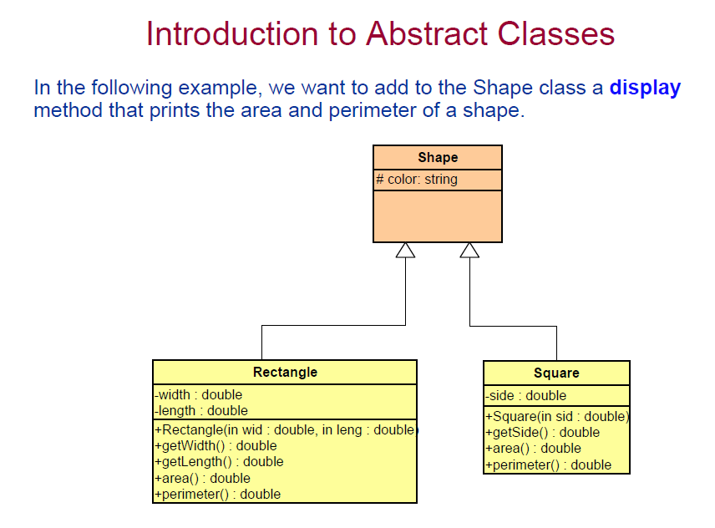

Slide 23
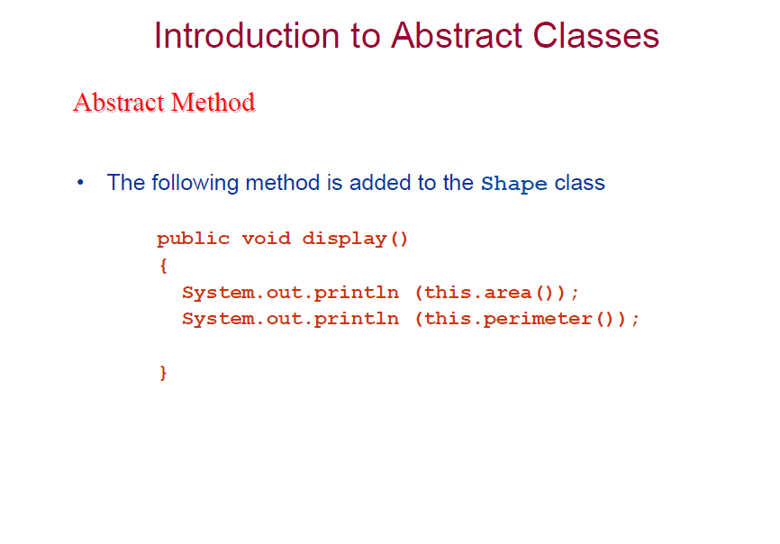

Slide 24
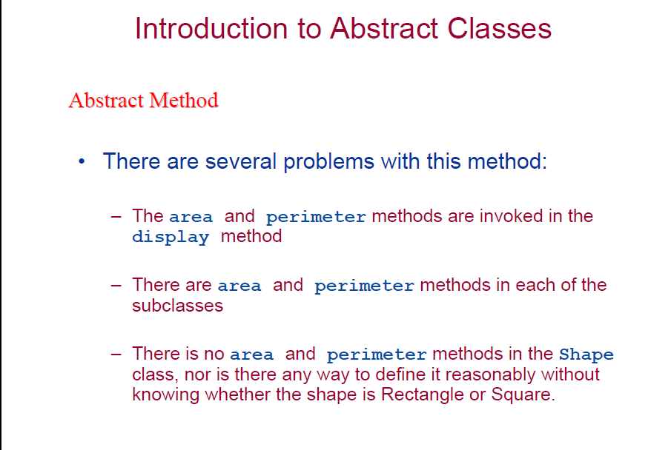

Slide 25
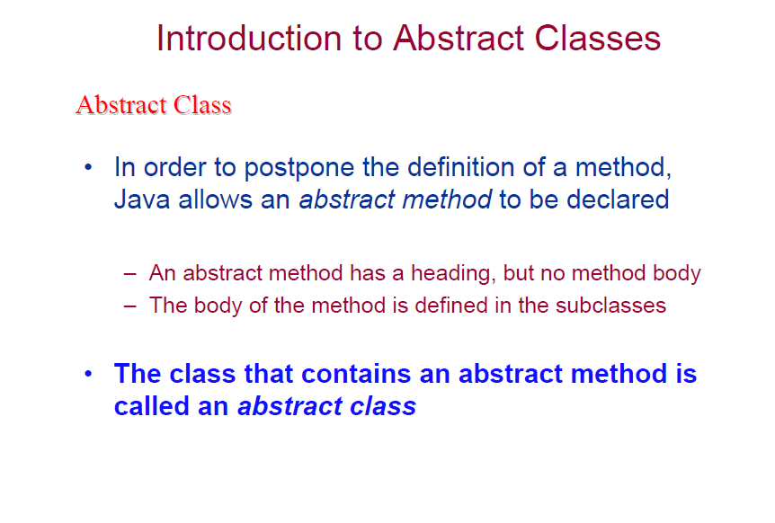

Slide 26
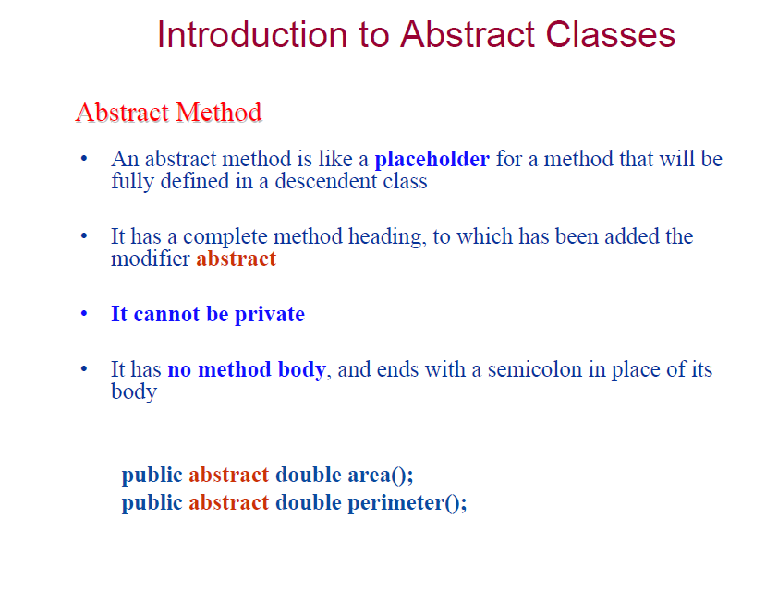

Slide 27
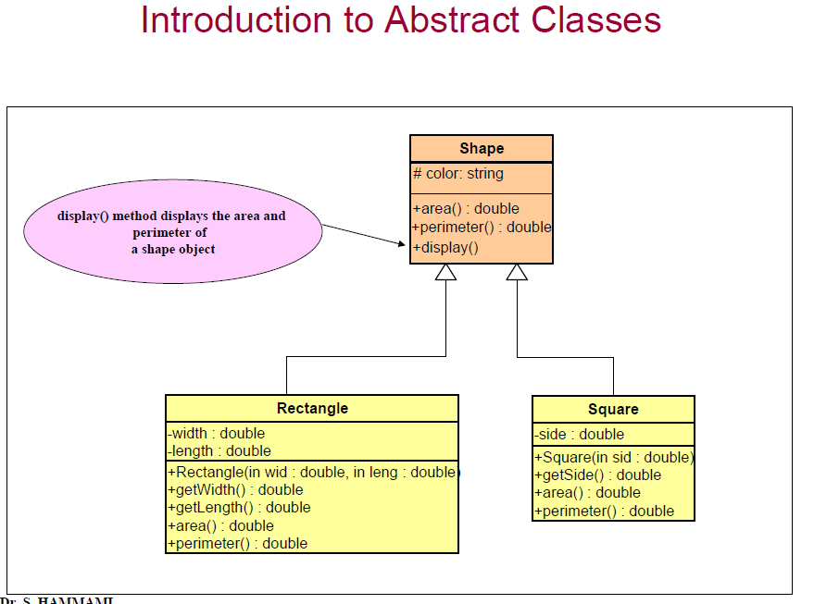

Slide 28
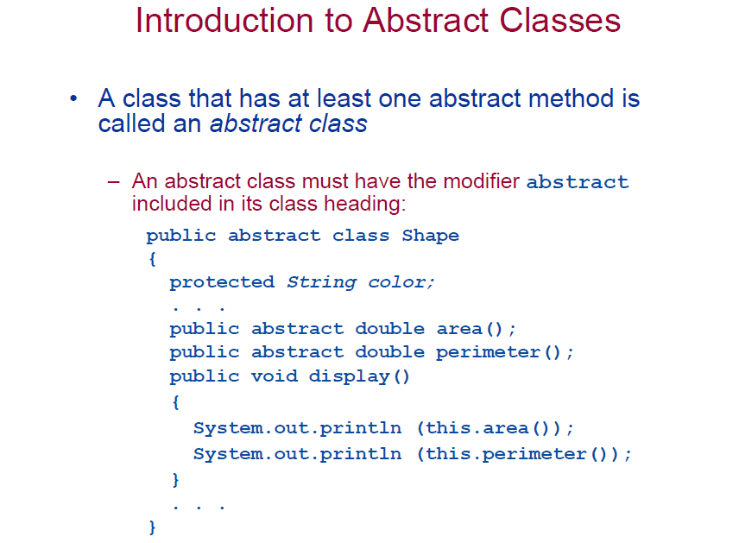

Slide 29
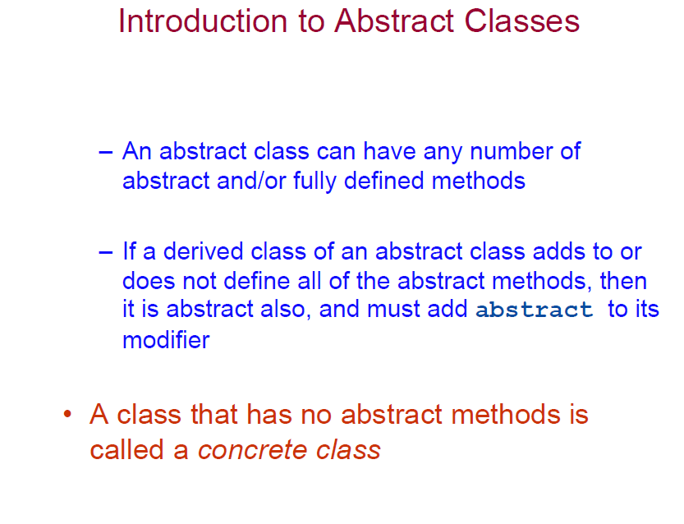

Slide 30
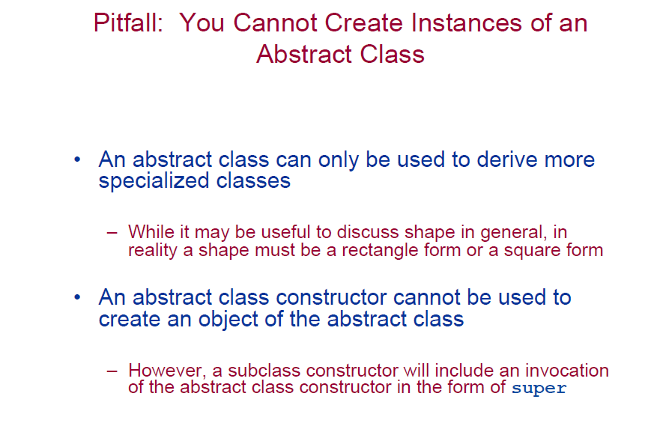

Slide 31
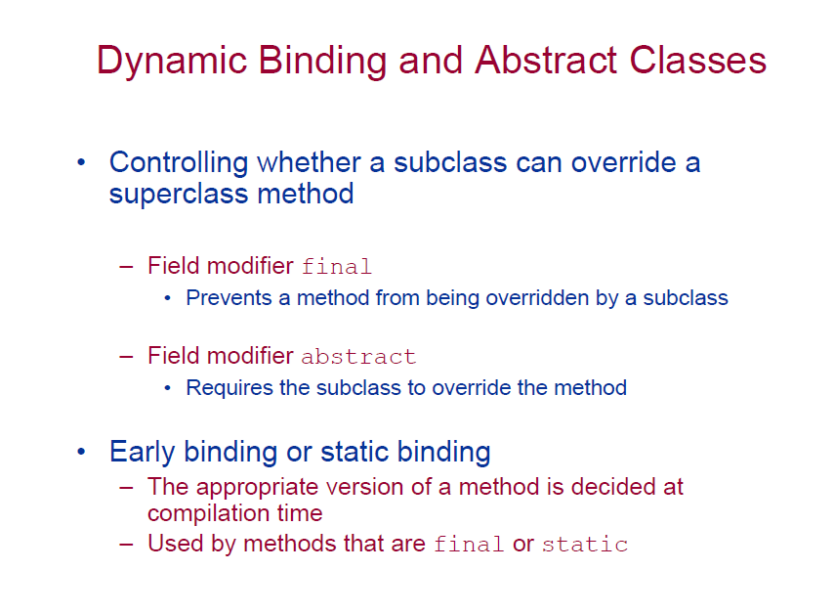

Slide 32
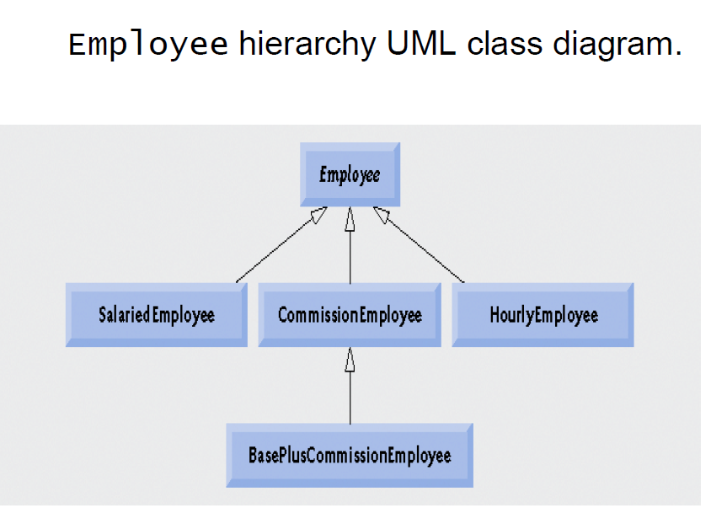

Slide 33
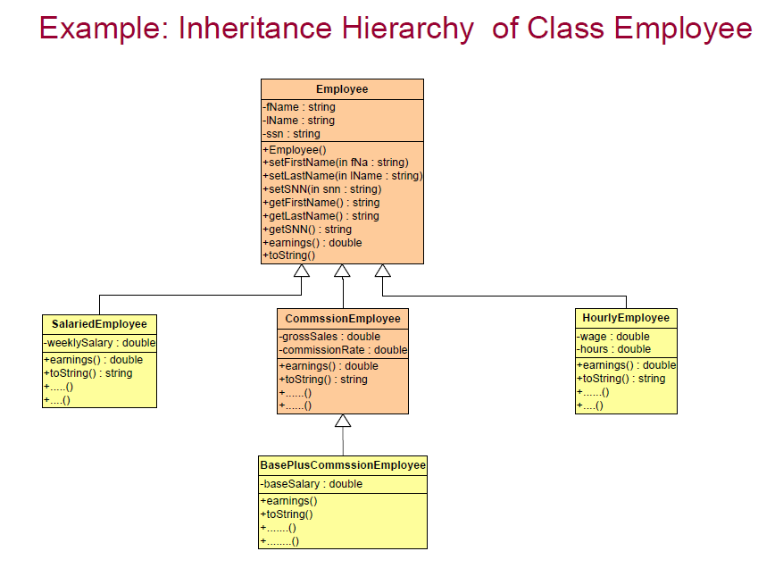

Slide 34
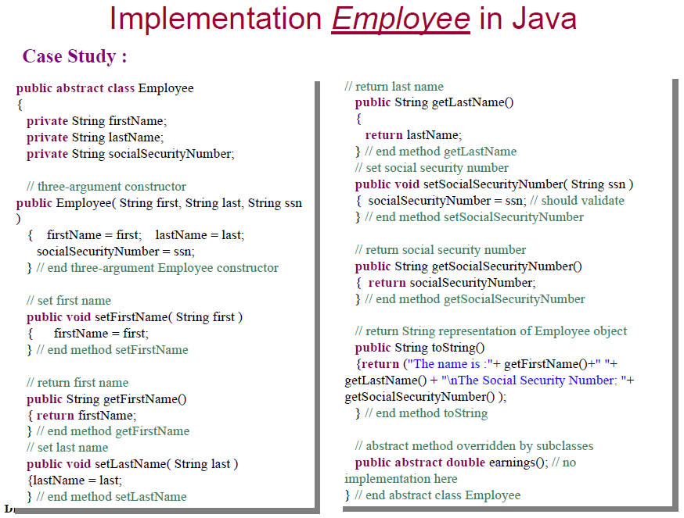

Slide 35
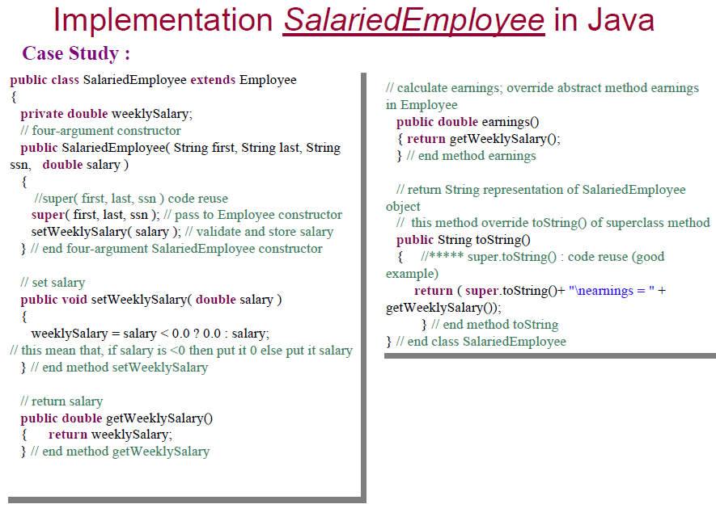

Slide 36
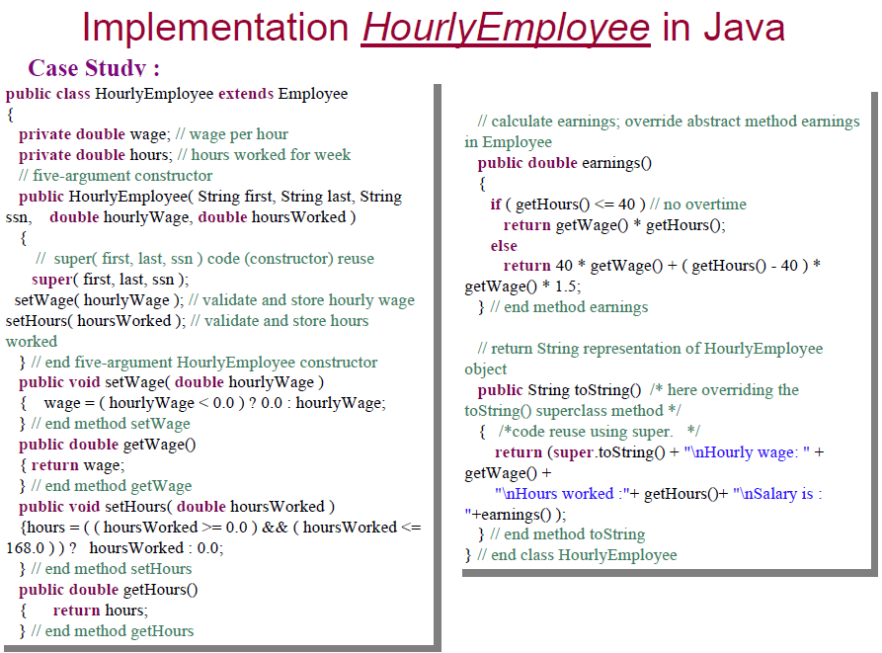

Slide 37
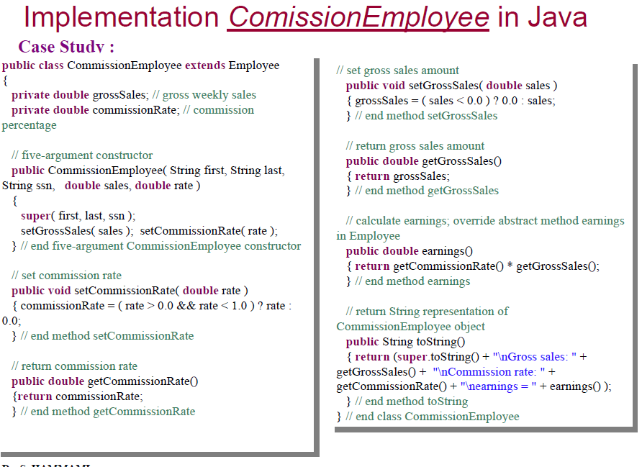

Slide 38
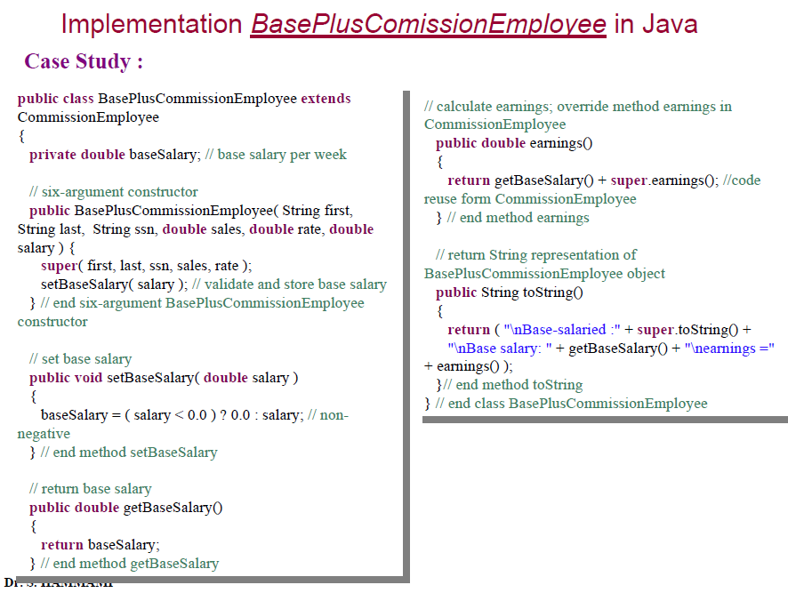

Slide 39
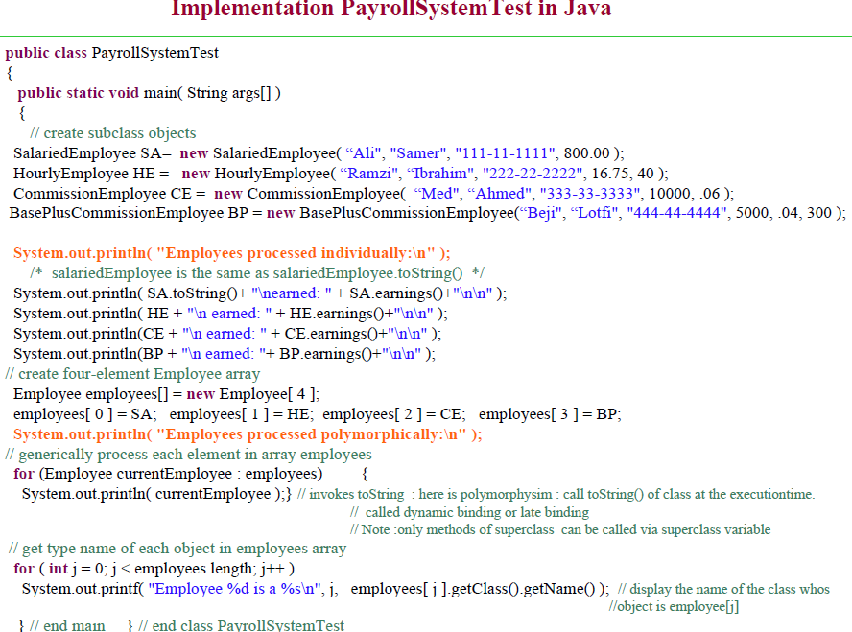
Using polymorphism concept
Using polymorphism concept
for (int i=0; i< employees.length, i++){
Employee currentEmployee= employess[i];
System.out.println(currentEmployee.toString()+” “+currentEmployee.earnings() ) ;
}

Slide 40
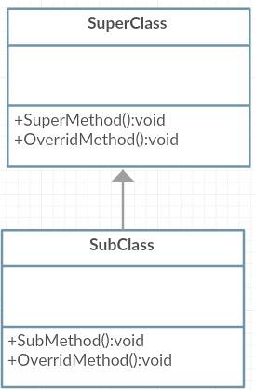


Casting Objects
Casting shows the use of an object of one type in place of another type, among the objects permitted by inheritance and implementations.
SuperClass obj = new SubClass(); //upcast
Obj.OverridMethod(); // call Obj.OverridMethod()in SubClass
Obj.SubMethod() ; // NO access

Slide 41
Casting Objects
How to access the method in the subclass ?
By casting an individual instance to its subclass form, one can refer to any property or method.
Suppose Sub1 class extends from SuperClass
SuperClass obj = new SubClass();
if (obj instanceof SubClass)
{
SubClass subObj = (SubClass) obj;
subObj.SubMethod();//calling method in sub class
}

Slide 42
Casting Case Study
Animal <abstract>
- age:int
+ Animal (in:age: int) + feed() +Shower ()
Farm
- numAnimals:int
+ Farm(in:size: int) + AddAnimal(in A:Animal ) +FeedAndShower() +CollectChickenEggs()
* animals 1
Chicken
+ Chicken(in:age: int) +Chicken (in C: Chicken) + feed() +CollectEggs()
Cow
- breed: String
+ Cow(in:age: int, in b: String) +Cow (in C: Cow) + feed() +Milk()

Slide 43
Class Farm (1\2)
public class Farm { private Animal[] animals; private int numAnimals; public Farm (int size) { animals = new Animal[size]; numAnimals=0; }
// The method adds the recived Animal to the farm(Notice the relation type) public void AddAnimal(Animal A) { if (A instanceof Cow) animals[numAnimals] = new Cow((Cow)A); else if (A instanceof Chicken) animals[numAnimals] = new Chicken((Chicken)A); numAnimals++; }

Slide 44
Class Farm (2\2)
//This method should feed and shower all animals in the farm public void FeedAndShower() { for (int i=0; i<numAnimals ; i++) { animals[i].feed(); animals[i].shower();} }
//This method should collect the eggs from all the chicken in the farm public void CollectChickenEggs() { for (int i=0; i<numAnimals ; i++) if (animals[i] instanceof Chicken) ((Chicken)(animals[i])).CollectEggs(); }}

Slide 45
Revision abstract
An abstract class is a class that is declared with abstract keyword.
An abstract method is a method that is declared without an implementation.
An abstract class may or may not have all abstract methods. Some of them can be concrete methods
A method defined abstract must always be redefined in the subclass.
Any class that contains one or more abstract methods must also be declared with abstract keyword.
You can't create object of an abstract class..
An abstract class can have parametrized constructors and default constructor is always present in an abstract class.

